Slide 1
Técnicas de Análisis de texto

Slide 2
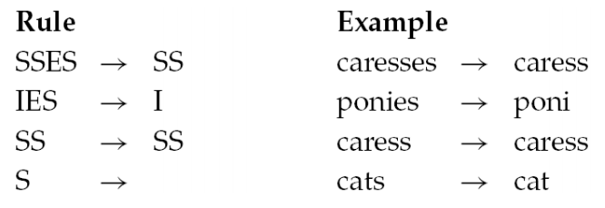
Stemming
Algorithmic: a crude heuristic process that chops off the ends of words in the hope of being correct most of the time
– Often remove derivational affixes
Porter’s algorithm hope of being correct most of the time

Slide 3
Lemmatization
Dictionary-based stemming
Use a vocabulary and morphological analysis of words to remove inflectional endings only and return the base or dictionary form of a word (lemma)
“ saw ” → “ see ” or “ saw ” depending on whether the token is used as a verb or a noun
Can bring very modest benefit for retrieval in English – improving recall but may hurt accuracy

Slide 4
Word Classes
Called: parts-of-speech, lexical categories, word classes, morphological classes, lexical tags...
9 traditional word classes of parts of speech
Noun, verb, adjective, preposition, adverb, article, interjection, pronoun, conjunction

Slide 5
Defining POS Tagging
The process of assigning a part-of-speech or lexical class marker to each word in a corpus:
WORDS
TAGS
the
koala
put
the
keys
on
the
table
N
V
P
DET

Slide 6
Choosing a POS Tagset
To do POS tagging, first need to choose a set of tags
Could pick very coarse (small) tagsets
N, V, Adj, Adv.
More commonly used: Brown Corpus (Francis & Kucera ‘82), 1M words, 87 tags – more informative but more difficult to tag
Most commonly used: Penn Treebank: hand-annotated corpus of Wall Street Journal, 1M words, 45-46 subset

Slide 7
Some Examples
N noun chair, bandwidth, pacing
V verb study, debate, munch
ADJ adjective purple, tall, ridiculous
ADV adverb unfortunately, slowly
P preposition of, by, to
PRO pronoun I, me, mine
DET determiner the, a, that, those

Slide 8
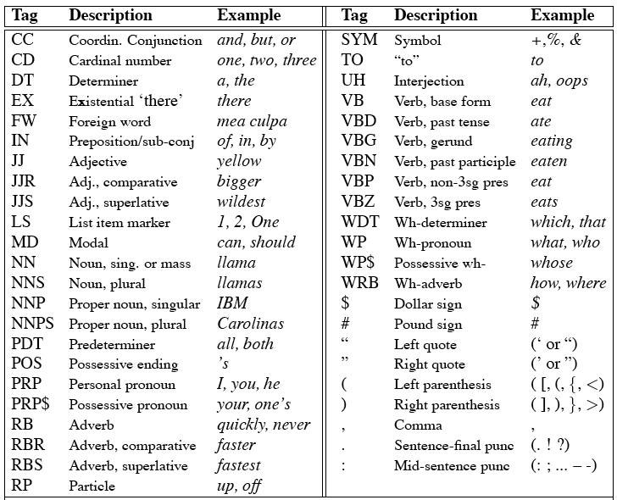
Penn Treebank Tagset

Slide 9
Tag Ambiguity
Words often have more than one POS: back
The back door = JJ
On my back = NN
Win the voters back = RB
Promised to back the bill = VB
The POS tagging problem is to determine the POS tag for a particular instance of a word

Slide 10
Tagging Whole Sentences with POS is Hard
Ambiguous POS contexts
E.g., Time flies like an arrow.
Possible POS assignments
Time/[V,N] flies/[V,N] like/[V,Prep] an/Det arrow/N
Time/N flies/V like/Prep an/Det arrow/N
Time/V flies/N like/Prep an/Det arrow/N
Time/N flies/N like/V an/Det arrow/N
…..

Slide 11
Different approaches
Rule-based Tagger
Stochastic POS Tagger
Simplest stochastic Tagger
HMM Tagger

Slide 12
Rule-Based Tagging
Typically…start with a dictionary of words and possible tags
Assign all possible tags to words using the dictionary
Write rules by hand to selectively remove tags
Stop when each word has exactly one (presumably correct) tag

Slide 13
Start with a POS Dictionary
she: PRP
promised: VBN,VBD
to: TO
back: VB, JJ, RB, NN
the: DT
bill: NN, VB
Etc… for the ~100,000 words of English

Slide 14
Assign All Possible POS to Each Word
NN
RB
VBN JJ VB
PRP VBD TO VB DT NN
She promised to back the bill

Slide 15
Apply Rules Eliminating Some POS
E.g., Eliminate VBN if VBD is an option when VBN|VBD follows “<start> PRP”
NN
RB
VBN JJ VB
PRP VBD TO VB DT NN
She promised to back the bill

Slide 16
Apply Rules Eliminating Some POS
E.g., Eliminate VBN if VBD is an option when VBN|VBD follows “<start> PRP”
NN
RB
JJ VB
PRP VBD TO VB DT NN
She promised to back the bill

Slide 17
Simplest Stochastic Tagger
Each word is assigned its most frequent tag (most frequently encountered in the training set)
Problem: may generate a valid tag for a word but unacceptable tag sequences
Time flies like an arrow
NN VBZ VB DT NN

Slide 18
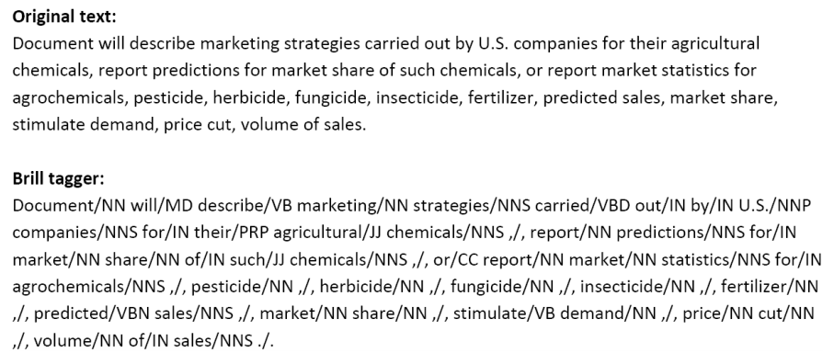
POS Tagger Example

Slide 19
Modelos estadísticos
Cadenas Ocultas de Markov (HMMS) (Cutting [CKPS92])
Modelos de Máxima Entropía (MEMMs) (Adwait Raatnaparakhi [Rat98])
Conditional Random Fields (CRFs) (Fei Sha and Fernando Pereira) [SP03])
Aplicaciones
Stanford Log-Linear Part-Of-Speech Tagger (Maximum Entropy
POS tagger)
Tweet POS tagger (Carnegie Mellon) -CRFs
POS tagger -freeling HMMs

Slide 20
N-gramas
¿Cuál es la probabilidad de una palabra w dada alguna historia h o P(w⎟ h)?
Sea h: la vida es color de y deseamos saber la probabilidad de que
la próxima palabra sea rosa:
P(rosa ⎟ La vida es color de )
Se puede computar esta probabilidad estimando conteos de frecuencia relativa:
P(rosa ⎟ La vida es color de) = C(La vida es color de rosa) /
C(La vida es color de)
!!!Sobre grandes corpus se puede calcular el conteo de palabras y
estimar la probabilidad !!!!

Slide 21
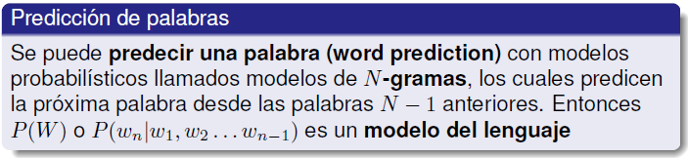
N-gramas
Probabilidad condicional
P(B⎟ A) = P(A⎟ B)/P(A)
Reescribiendo
P(A⎟ B) = P(A)P(B⎟ A)
Más variables:
P(A,B,C,D) = P(A)P(B⎟ A)P(C⎟ A;B)P(D⎟ A;B;C)
Regla de la cadena en general:
P(x1, x2, …, xn) = P(x1)P(x2⎟ x1)P(x3⎟ x1, x2) … P(xn⎟ x1, x2, … , xn-1)

Slide 22
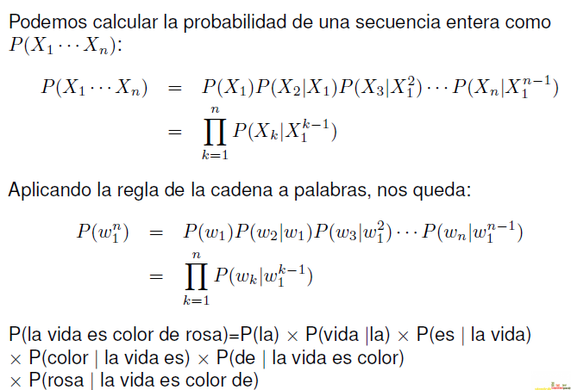
Regla de la cadena aplicada en secuencia de palabras

Slide 23
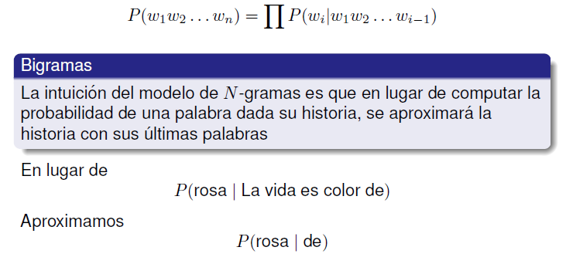
Regla de la cadena aplicado a la probabilidad conjunta

Slide 24
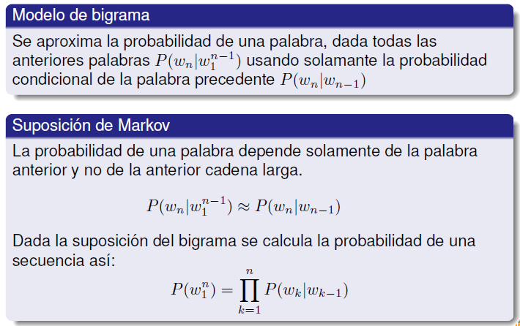
Modelo de bigramas

Slide 25
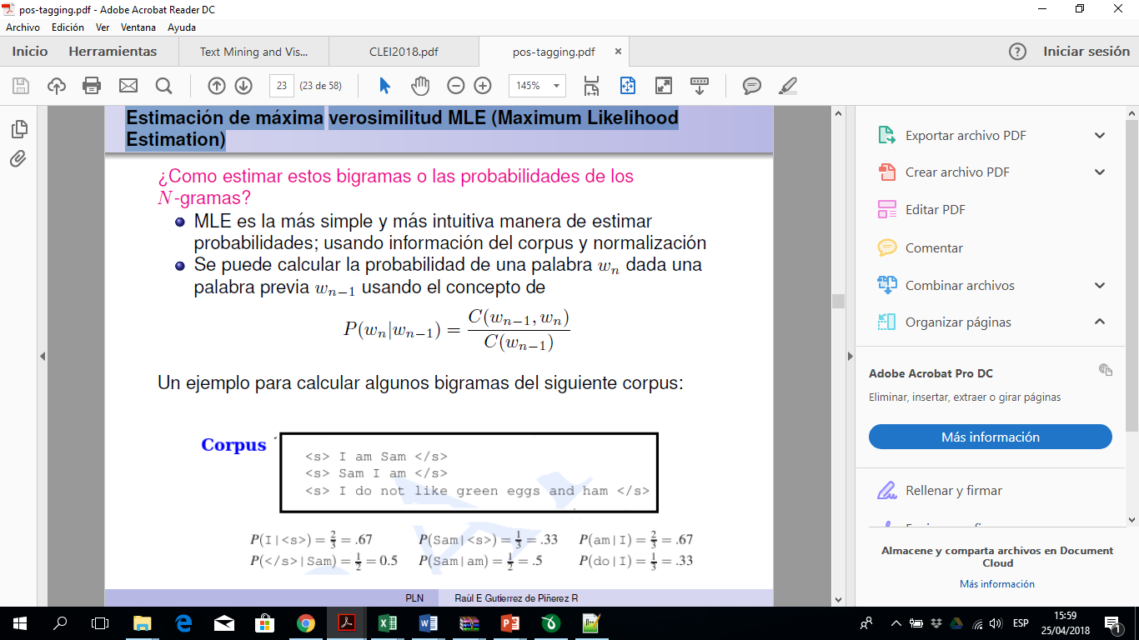
Estimación de máxima verosimilitud MLE (Maximum Likelihood Estimation)

Slide 26
Estimación de máxima verosimilitud MLE (Maximum Likelihood Estimation)

Slide 27
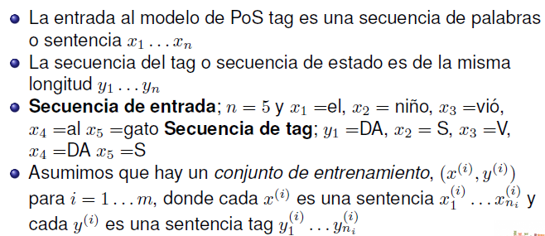
Sequence labeling problem, or a tagging problem

Slide 28
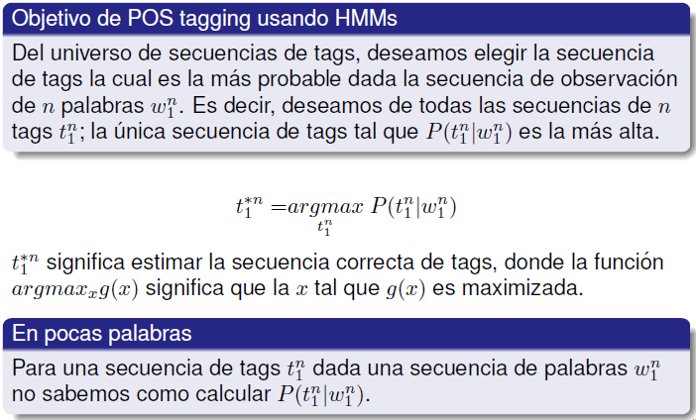
Etiquetadores estocásticos (HMMs Cadenas Ocultas de Markov)

Slide 29
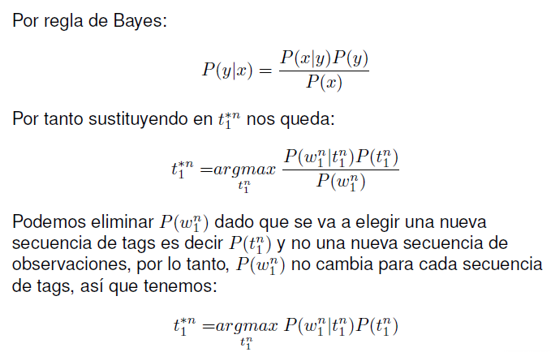
Bayesiano

Slide 30
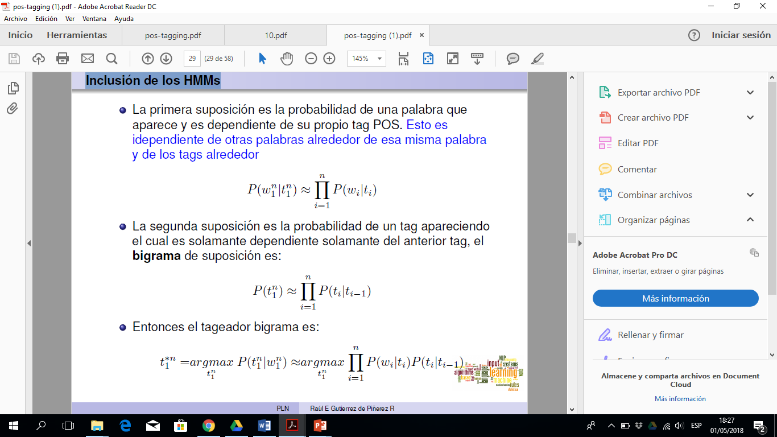
Inclusión de los HMMs

Slide 31
Inclusión de los HMMs

Slide 32
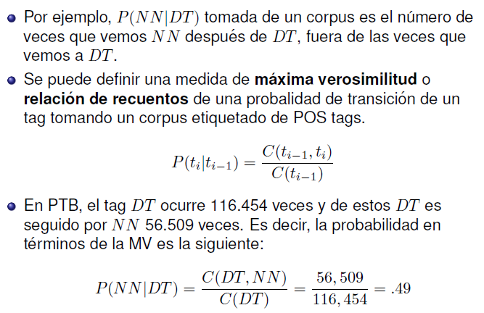
Máxima Verosimilitud (MV)
Esta es la probabilidad de obtener un sustantivo común después
de un determinante

Slide 33
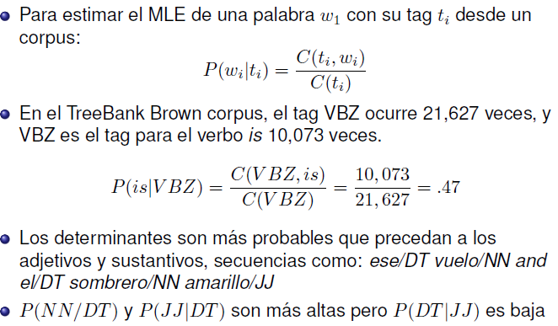
HMMs en POS tagging

Slide 34
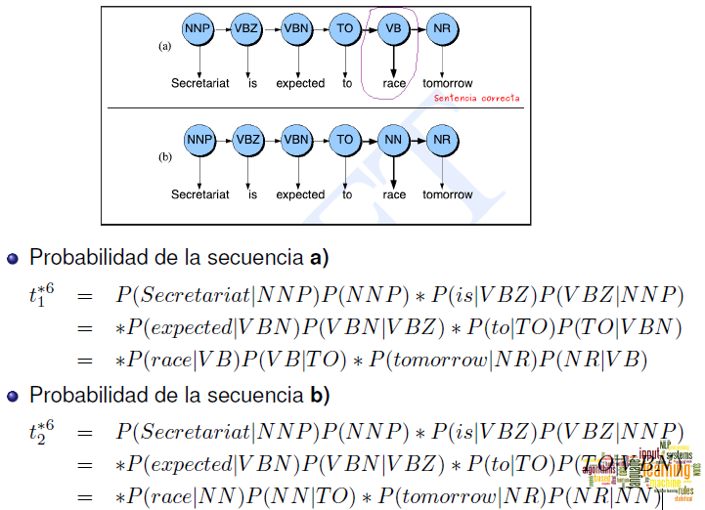
Cálculo de probabilidad de las dos secuencias

Slide 35
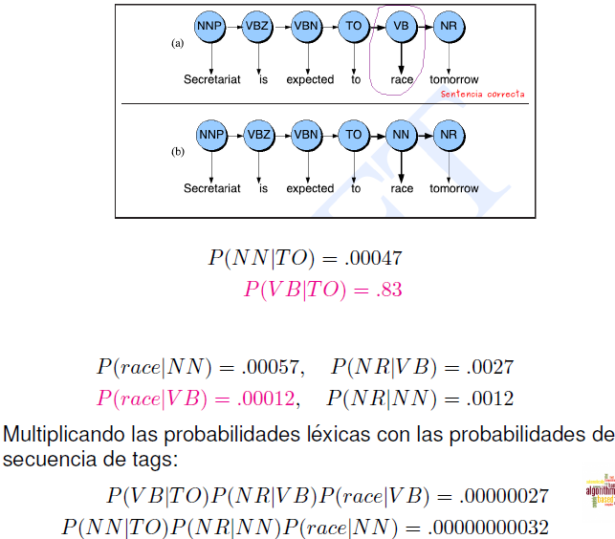

Slide 36
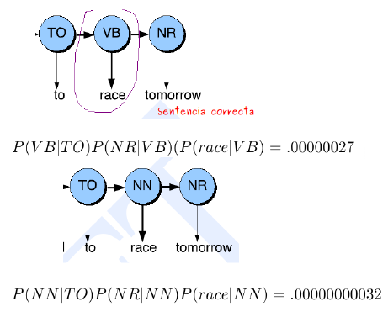
Es más probable race como verbo

